Slide 1
WIND TUNNEL TESTING OF CANARD WING

Slide 2
AIM OF THE PROJECT:
To do a comparative study of the airfoils
To conduct a wind tunnel testing of the canard wing
To fabricate a model of a canard wing aircraft

Slide 3
COMPARISON OF AIRFOIL PERFORMANCE WITH XFLR5:
Airfoils such as:
1. NACA 2412
2. NACA 4415
3. NACA 3412 are analyzed with XFLR5 software.
The parameters such as flow analysis, coefficient of lift, coefficient of drag, Cl vs angle of attack graph are compared and the airfoil suitable for our requirements was chosen.
CHOSEN AIRFOIL – NACA 2412

Slide 4
DESIGNING OF THE CANARD AIRFOIL WITH CATIA:
The chosen airfoil- NACA 2412 is designed according to the required dimensions using CATIA v5
The dimensions are as follows
1. Canard wing root chord: 130mm
2. Canard wing tip chord: 81.2mm
3. Taper ratio of the canard wing: 1.6
4. Length between root and tip: 230mm

Slide 5
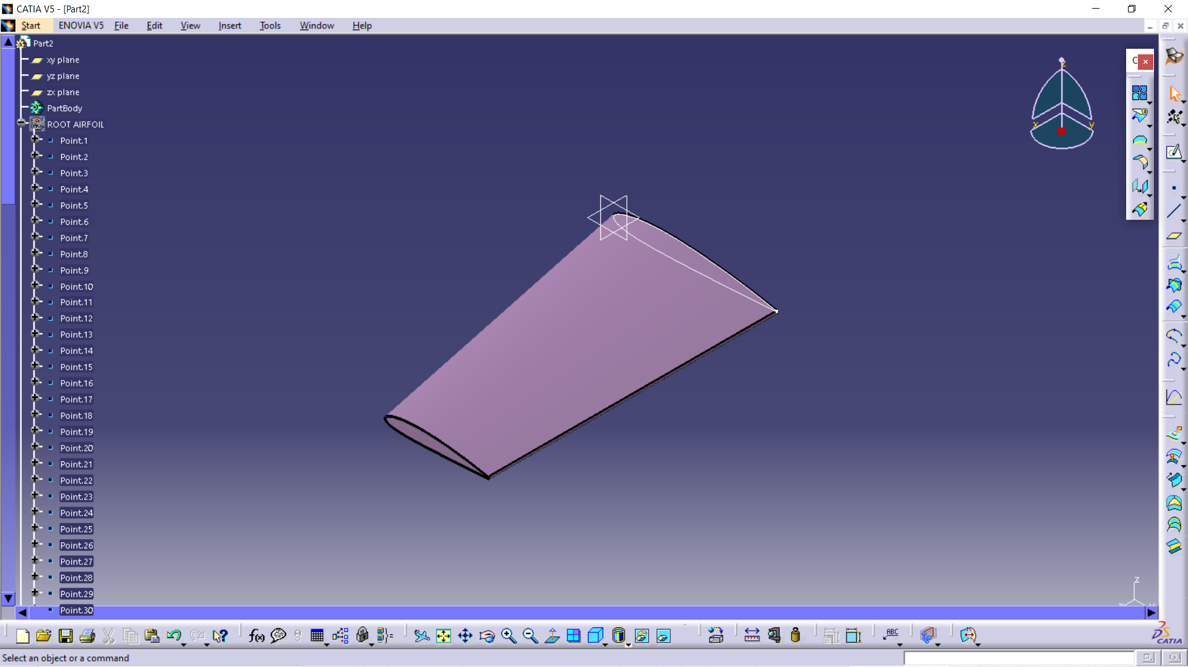
Finalized CATIA model of canard wing:

Slide 6
UPCOMING PROGRESS TO BE DONE: a) 3d printing b) fabrication and wind tunnel testing c) fabrication of the aircraft model

Slide 7
3D PRINTING OF THE MODEL:
General procedure of 3d printing:
The model of the wing which has to be fabricated is designed using CATIA
Acrylonitrile butadiene styrene commonly called as ABS is used for fabrication of the wing.
This material is used because of its impact resistance and toughness.
It is used as an extruded filament for 3d printing.

Slide 8
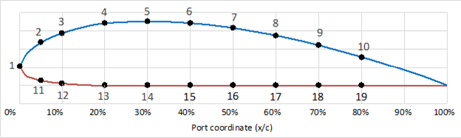
PRESSURE PORTS FOR THE WING:
Pressure ports are normally holes which are used to measure the pressure or the pressure difference in the airflow
A point is placed at the leading edge as it is the point where the wing experiences the maximum pressure

Slide 9
PARAMETERS TO BE CALCULATED WITH WIND TUNNEL:
Coefficient of lift
Coefficient of drag
Centre of pressure(Cp)
Lift/ drag ratio
Flow pattern over the airfoil
The point of flow separation

Slide 10
WIND TUNNEL PROCEDURE
Read the temperature and the pressure inside the lab, or inside the wind tunnel
Use these values to compute mass density of air inside the lab using the ideal gas law
Use wind tunnel to measure the pressure difference(using a manometer)
The pressure difference is measured using the formula

Slide 11
WIND TUNNEL TESTING OF THE CANARD WING:
The canard wing of the designed dimensions by CATIA will be tested in the wind tunnel by fabricating it through the 3d printing.
The material used for the fabrication of the wing used for wind tunnel will be ABS
The dimensions will be same as mentioned in the CATIA

Slide 12
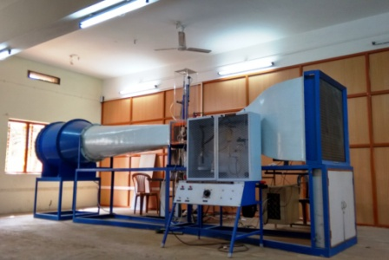
The velocity at which the wing is tested is about 20m/s(72kmph, Mach no: 0.058)
WIND TUNNEL SPECIFICATION:
Type of wind tunnel: Low speed open circuit suction type
Test section size: 600*600*4000mm

Slide 13
FABRICATION OF A MODEL OF A CANARD WING AIRCRAFT:
The aircraft model will be fabricated with Styrofoam and balsawood.
The dimensions are as follows:
Main wing span = 120cm
Chord length = 23cm and 14cm
Mean chord = 18.5cm
Main wing area = 2200sq.cm
Canard wing span = 56cm
Taper ratio = 1.6
Canard wing chord = 13cm and 8.12cm
Canard mean chord = 10.56cm

Slide 14
Canard wing area = 591sq.cm
LE to LE distance = 35cm
Nose length = 8cm
Airfoil used =NACA 2412
Fuselage shape = square
Size of the fuselage = 14cm
Main and canard wing configuration = high wing
Main wing aspect ratio = 6.48
Canard wing aspect ratio = 5.30
Canard airfoil thickness = 1.267cm
Elevator width = 6cm
Aileron width =4cm
Rudder width = 4cm
Stabilizers area =480sq.cm
Stabilizers position = at rear end of the fuselage (10cm behind the main wing)
Total length of the model = 8cm + 13cm- +28cm+ 23cm +10cm +15cm = 97cm

Slide 15
TIMELINE:
The fabrication and wind tunnel testing: 19.02.2020 to 21.02.2020
Fabrication of the aircraft: 28.02.2020
Completion of the model: 02.03.2020

Slide 16
THANK YOU

